Slide 1
Employee Data Analysis using Excel
STUDENT NAME: S.V.AISHWARYA
REGISTER NO: 312216902
DEPARTMENT: B.COM (GENERAL)
COLLEGE: SHRI KRISHNASWAMY COLLEGE FOR WOMEN

Slide 2
PROJECT TITLE
Salary and compensation analysis through Excel data Modelling

Slide 3


AGENDA
Problem Statement
Project Overview
End Users
Our Solution and Proposition
Dataset Description
Modelling Approach
Results and Discussion
Conclusion
3/21/2024 Annual Review

Slide 4

PROBLEM STATEMENT
This problem statement outlines the business context, the challenges faced, the data sources involved, and the objectives and requirements for the data modeling task. It provides a clear direction for designing a data model that can support the desired business outcomes.

Slide 5

PROJECT OVERVIEW
The primary goal of this project is to analyze salary and compensation data using Excel data modeling techniques. The analysis aims to identify trends, disparities, and insights that can help in making informed decisions related to employee compensation, salary adjustments, and overall compensation strategy.

Slide 6

WHO ARE THE END USERS?
Conducting a salary and compensation analysis through Excel data modeling involves several steps. This process can be useful for HR professionals, finance teams, or any decision-makers involved in determining fair and competitive salaries within an organization.

Slide 7

OUR SOLUTION AND ITS VALUE PROPOSITION
Conducting a salary and compensation analysis through Excel data modeling offers several compelling value propositions, particularly for HR professionals, finance teams, and organizational leadership.

Slide 8
Dataset Description
The dataset is a structured collection of data points relevant to employees' compensation. This dataset should include various variables that capture different aspects of employees' pay, benefits, and related attributes.

Slide 9

THE "WOW" IN OUR SOLUTION
It involves creating a structured process to analyze and interpret the data effectively. This solution can be implemented using Excel and consists of several key steps, from data preparation to final analysis and visualization.
3/21/2024 Annual Review
9

Slide 10
MODELLING
This Excel-based data modeling solution provides a powerful and flexible approach to analyzing salary and compensation data, enabling organizations to ensure fair, competitive, and strategic compensation practices.
10

Slide 11
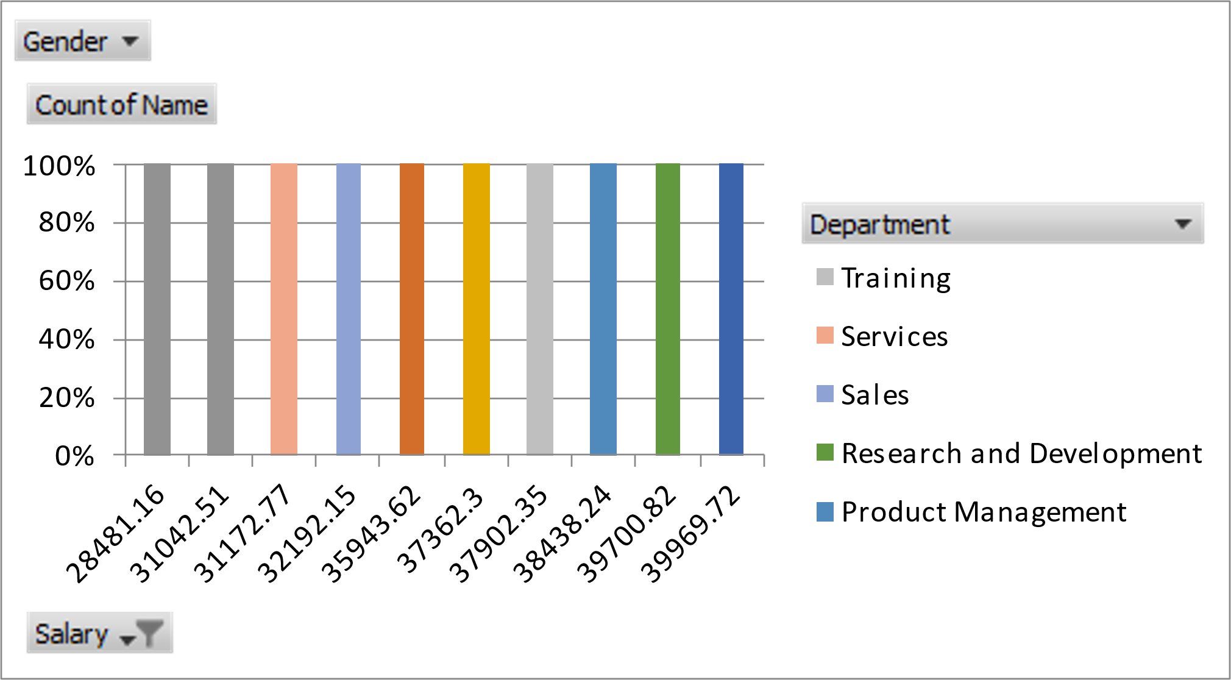
RESULTS
11

Slide 12
conclusion
The implementation of salary and compensation analysis through Excel data modeling offers a powerful, flexible, and cost-effective solution for organizations seeking to optimize their compensation strategies. By leveraging Excel’s robust data handling, analytical, and visualization capabilities, companies can gain valuable insights into their compensation structures, ensuring they remain competitive in the marketplace while maintaining internal equity.

